Slide 1
COMP SCI 2103/7103 Algorithm Design & Data Structure Lecture 1 - Course Profile and Assessment Information
School of Computer Science
Notes:
This PowerPoint has been created for you to customise for your course. It can be used for your first lecture with students and uploaded to your MyUni course.
When you have finished customising the slides save as a PowerPoint Show ( .PPS)
Show students where they can access this PowerPoint in the MyUni course.

Slide 2
Welcome
Welcome to CS 2103/7103, Algorithm Design and Data Structures.
In this lecture we will:
Discuss some key administrative issues.
Describe what we’re going to do in this course.
Talk about what to do this week.
Notes:
Check with students whether they have finished OOP or not

Slide 3
Pre-requisites
Who should be here?
You have passed CS1102/1202 (OO Programming)
Who should not be here?
Anyone who has done CS2004 (DSA) or CS1103/2103.
Anyone who has not passed 1102/1202!

Slide 4
Course Outline
Week 1-5: ADTs, Inheritance, Design, Recursion, Polymorphism, Complexity analysis of algorithms, Sorting and Searching
Week 6-12: Data Structures: Linked Lists, Stacks, Queues, Heaps, Trees and Graphs, Algorithmic strategies.
Assumed Knowledge
You can design and build simple object-oriented programs in C++, including classes and memory management.
Notes:
ADDS is not designed to be a programming course.
The key point of the course : complexity analysis, the design and analysis of algorithms , the common data structure
As computers become faster and faster, the need for program…
The goal of this course is to help you develop good programming and algorithm analysis skills simultaneously so that you can develop such programs with the maximum amount of efficiency.

Slide 5
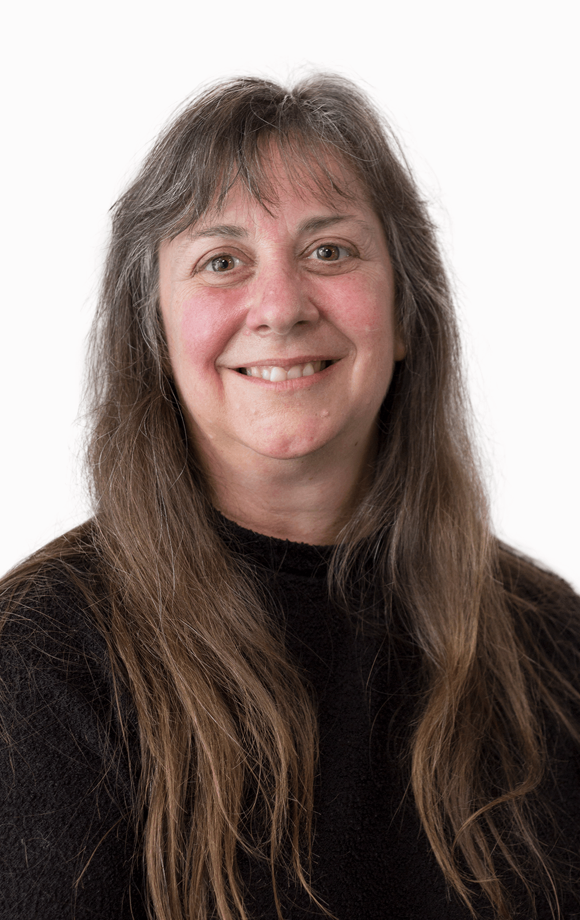

Teaching Staff
Dr Cheryl Pope
Lecturer (weeks 1-5) & Course Coordinator
Dr Chitchanok Chuengsatiansup
Lecturer (weeks 6-12)
Practical Demonstrators / Workshop Supervisors:
Ravi, Matthew, Sree, April, Josh
Available only during scheduled practical sessions.
Notes:
Discussion board

Slide 6

Course Organisation
How the course is structured:
Three hours of lectures (will include practice/examples) per week
1 x 2 hour practical sessions every week.
1 x 1 hour workshop every fortnight
Lectures
Understand theory to answer questions
Use theory to implement solutions
Walter Savitch: Problem Solving in C++
10th Global Edition
Workshops
Practicals
Notes:
It is suggested that you go through the MyUni Course as you outline what the course is about and what students have to do to pass.
Show students where they can find:
Readings
Lecture notes
Lecture recordings
Assessments

Slide 7

Covid-19 precautions
Lectures
Live streamed through Echo 360 at scheduled time with live Q&A
Recording available after
Workshops
Wear masks if able
Hand hygeine
Practicals
Clean mouse/keyboards before/after use
Wear masks if able
If you are unwell DO NOT come in to campus
You can join one of the online workshop or practical sessions
Asynchronous options for completing workshop/practical work
Piazza board discussion with peers
Details in practical/workshop sheets
Notes:
COVID-19 image: Image Library | CDC Online Newsroom | CDC

Slide 8
On campus or remote?
The assessments, activities and schedule is identical whether you are on campus or remote.
The only difference is that if you are remote, you will be enrolled in the online workshop and practical session which is held in Zoom.
Notes:
World Map: Fibonacci - Own work based on: BlankMap-World6, compact.svg and World using the four color theorem.png.

Slide 9
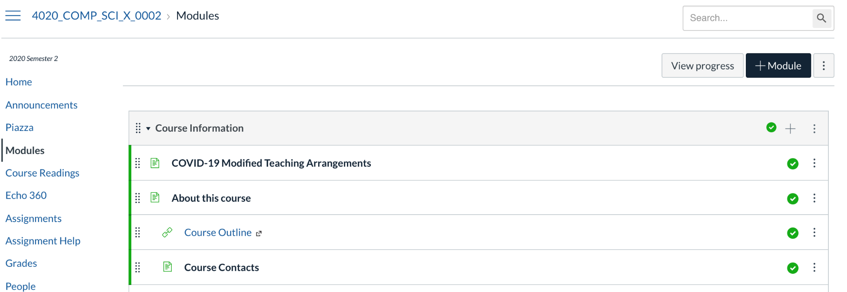
Where to find information and get help
The Course Information module in MyUni contains links to all the important course information
If you have any questions regarding this course and cannot find the answer in there ask on the Piazza discussion board.

Slide 10
Assessment
Notes:
.

Slide 11
Assessment
This course has 3 components:
3 examinations
1) Week 4 during your scheduled practical – 10%
2) Week 8 during your scheduled practical - 10%
3) Final Exam period – 50%
Workshops (5%)
Practicals (25%)
You are expected to participate in all activities.
Hurdle: You need at least 40% of the mark of the final examination to pass this course.)
Notes:
Go through each assignment:
Where students find them on the MyUni course
Due dates
what each one involves
Marking criteria

Slide 12
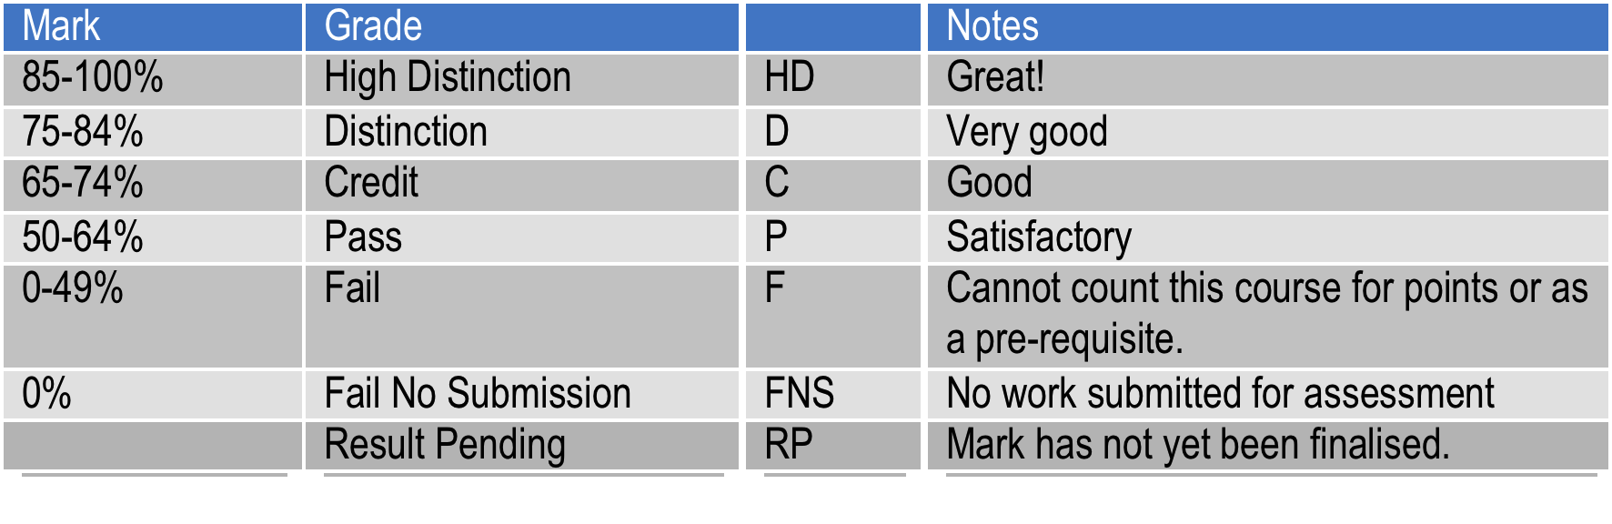
Grades
If you see an RP on your transcript, it means that your mark is not currently available. If you don’t know why, you should contact your course coordinator.

Slide 13
Lectures
3 scheduled each week – we may not always use all 3
Covers the theory and demonstrates code examples
Workshop and practical assumes the knowledge from the lecture.
If you are not prepared,
your workshop tutor can mark you as not being an active participant in the workshop
Your practical tutor can refer you back to the lecture
It’s unfair to others if your tutors or your peers have to catch you up on lecture content. Be prepared!

Slide 14
Practicals
Due every week except prac exam weeks
You can collaborate with peers
As long as you contribute to the solution
As long as you understand the work submitted
You acknowledge the names of peers you worked with in your submission as a comment at the top
You must make your own submission to receive credit
Tutors are available to assist and answer questions during your practical session
Solving the practical assignments prepares you for practical examinations and is key for your success in this course.

Slide 15
Workshops
Every other week starting week 2
You must collaborate with peers
There will be a problem that you are required to solve and/or discuss as a group
There will be work that you need to create as a group
Group work will be presented
Your tutor will guide you in these activities
Credit is based on preparation and active participation in the specified activities.
Working through the workshop problems and presenting solutions prepares you for answering theory questions and helps you to develop fluency in the vocabulary of Algorithms and Data Structures.

Slide 16
Exams
Exams are NOT collaborative
You can not consult or ask questions of ANY other person
Open Book
Internet Access
OK: search for information and then, without copying, write your solution
NOT OK: search for the information and then copy it, even if you make small changes
NOT OK: search for the exact question
Each exam will be a combination of theory questions and coding problems
Replacement exams will only be offered on documented grounds as covered in the Modified Arrangements for Coursework Assessment policy.

Slide 17
Exams
The first two exams will be held in the lab or during your online practical session if you are studying online in week 4 and week 8 .
You must attend your enrolled practical session these weeks.
You must not post or discuss the exam until the end of the exam week.
Final exam
Held during the University exam period
Written exam
Wayville for on-shore students
online-proctored for off-shore students

Slide 18
Late Submissions
You should hand your coursework in on time.
If you hand in your practical late, your mark will be capped, based on how many days late it is.
1 day late – mark capped at 75%
2 days late – mark capped at 50%
3 days late – mark capped at 25%
more than 3 days late – no marks available
Late submissions do not apply to exams. Exams close at the end of the time period and no further work is accepted
One late assignment will turn into two, three or more!
Hand in early!
Notes:
Please customize according to your requirements

Slide 19
Repeating Students
Students who repeat a course are expected to attempt all of the aspects of the course again. This includes making fresh attempts at all coursework assessment items.
You may apply to the course coordinator to have your previous work counted but this is not usually granted.
Make sure that you attend all of the lectures, do all of the work and study hard for the exam – you don’t want to get stuck repeating the same course over and over.

Slide 20
Modified arrangements

Slide 21
Assignment extensions and replacement exams
I follow the Modified Arrangements for Coursework Assessment policy
https://www.adelaide.edu.au/policies/3303/?dsn=policy.document;field=data;id=5702;m=view
In a nutshell
Check that your reason for wanting an extension or replacement exam is covered in that policy
Send me the supporting evidence (the policy states what this is)
Tell me the new due date you are requesting
Put your exam dates in your calendar. You are expected to attend your exams.
I do not grant replacement exams due to a clash with another course unless your lecturer contacts me with evidence of why your other course activity can not be moved.
You may be able to negotiate to take your exam earlier, but you can not take it later.

Slide 22
Assignment extensions
Extensions will not be granted for circumstances including minor ailments; travel, employment, family, customary, sport or leisure commitments; problems with balancing workloads; normal exam stress or anxiety.
If you think your situation is exceptional, contact your course coordinator ASAP, who will then consult the Head of School.
Students who deliberately submit false or fraudulent documentation may be referred to the Student Misconduct Tribunal.
You will normally only receive an extension equivalent to the number of days covered by your documentation. Don’t expect to get an extra week because you lost a day.

Slide 23
Absence during the semester
You are expected to be able to attend all activities from the start of semester through the end of the R/AA exam period.
If you leave Adelaide, or the state, or the country we will not provide extensions or move examinations.
If you have a genuine medical or compassionate reason that requires you to leave the University during the academic year, you should get in contact with the course coordinator immediately to discuss your options.

Slide 24
Examinations
Go to the University Examinations Site for information on Examinations:
http://www.adelaide.edu.au/student/exams/
This includes timetable information, and information on what you can take with you into the exam.
Also includes policies for examinations and additional/replacement examinations
Supplementary exams are usually held shortly after results are announced.
Check the above link for timetable and other information
Notes:
Where they can find information about examinations. We (academic staff) are not allowed to tell students anything about the examination (i.e. location, time, date, what they can bring in). They have to get this information from the exam site or office.
They should also check out this site to check out exam policies.

Slide 25
Additional assessment
For Level 2 and above courses:
If your final result is 45-49, additional assessment (assignment, exam) is automatically granted.
In the case where an additional exam is granted, the better of the primary or additional exam results is used to calculate your final grade.
If any kind of additional assessment is granted your overall result for the course is capped at 50P.
You must make yourself available during the additional assessment period.

Slide 26
Replacement exams
Replacement exams will not be granted for circumstances including minor ailments; travel, employment, family, customary, sport or leisure commitments; problems with balancing workloads; normal exam stress or anxiety.
Students granted a replacement exam are not eligible to sit the primary exam.
Students who sit the primary exam will not be eligible to apply for a replacement exam unless a major issue arose during the exam.
Students must make themselves available during the replacement exam period.
Notes:
Emphasise that they have to make sure they are still in Adelaide during the supp period. This is the only second chance they will get, and if they are not here, and they need a supp, they will have to repeat the subject.

Slide 27
Replacement exams (cont.)
Students will not be entitled to an additional assessment if they have already sat a replacement exam, i.e., no supps on supps.
Students granted a deferred replacement exam will not be eligible to sit the primary exam or the replacement exam (only under exceptional circumstances will a deferred replacement exam be granted).
The University must notify students of the outcome of their replacement exam applications within 3 business days (if you already sat the primary exam, do not bother applying for a replacement exam).
Notes:
Emphasise that they have to make sure they are still in Adelaide during the supp period. This is the only second chance they will get, and if they are not here, and they need a supp, they will have to repeat the subject.

Slide 28
Replacement exams (cont.)
Students who deliberately submit false or fraudulent documentation may be referred to the Student Misconduct Tribunal.
For the full policy on Modified Arrangements, see:
https://www.adelaide.edu.au/policies/3303
Notes:
Emphasise that they have to make sure they are still in Adelaide during the supp period. This is the only second chance they will get, and if they are not here, and they need a supp, they will have to repeat the subject.

Slide 29
Additional/Replacement exam dates
Go to the University Examinations Site for information on Additional/Replacement exams:
http://www.adelaide.edu.au/student/exams/

Slide 30
Academic honesty policies

Slide 31
Academic Honesty Policies
The University has strict policies prohibiting students from presenting other people’s work as their own, whether that of students or from outside the University.
You may not copy code from another student or give another student your code to copy from, unless specifically authorised to do so by a staff member.
You may not copy code from anywhere else, without permission.
If caught, you may receive zero for the assignment, zero for the course or be expelled.
We don’t give you assignment work just to keep you busy, we do it to develop your understanding and ability to apply important techniques.
If you don’t do the work yourself, you won’t be able to do it in the examination and you won’t be able to do it in the work force.
Full policy available at the university webpages.

Slide 32
Violations of Academic Integrity policy
Plagiarism
Using another person’s ideas, designs, words or works without appropriate acknowledgment.
Collusion
Another person assisting in the production of an assessment submission without the express requirement, or consent, or knowledge of the assessor.
Workshops and practicals are there to support your learning. You are expressly encouraged to work together on them.
Exams are assessments of your skill level. You must not submit someone else’s answer.
If you have understood your practical and workshop work, you should be able to do the exam without assistance.

Slide 33
Violations to policy
Plagiarism
Using another person’s ideas, designs, words or works without appropriate acknowledgment.
Collusion
Another person assisting in the production of an assessment submission without the express requirement, or consent, or knowledge of the assessor.
1. Do not submit any work or part thereof which is not yours.
2. Do not submit any work for which you have received unfair assistance.

Slide 34
Example 1
I had finished my assignment, and a classmate was asking for help. Since I am a kind person, I
Gave the classmate a copy of my code (or part thereof).

Slide 35
Example 1
I had finished my assignment, and a classmate was asking for help. Since I am a kind person, I
Gave the classmate a copy of my code (or part thereof).
Posted my solution on an online forum for his/her reference.

Slide 36
Example 1
I had finished my assignment, and a classmate was asking for help. Since I am a kind person, I
Gave the classmate a copy of my code (or part thereof).
Posted my solution on an online forum for his/her reference.
Allowed the classmate to have a look at my code on paper/screen.

Slide 37

Example 1
I had finished my assignment, and a classmate was asking for help. Since I am a kind person, I
Gave the classmate a copy of my code (or part thereof).
Posted my solution on an online forum for his/her reference.
Allowed the classmate to have a look at my code on paper/screen.

Slide 38

Example 2
I had finished my assignment, and a classmate was asking for help. Since I am a kind person, I
Gave a few high-level tips to my classmate.
Discussed high-level concepts regarding the assignment with my classmate.

Slide 39
Example 3
My good friend/housemate/brother/twin and I are taking the same course. We have always worked together. When doing the assignment, we
Exchanged solutions to verify/compare our answers.

Slide 40
Example 3
My good friend/housemate/brother/twin and I are taking the same course. We have always worked together. When doing the assignment, we
Exchanged solutions to verify/compare our answers.
Divided the assignment work amongst ourselves to speed up progress.

Slide 41
Example 3
My good friend/housemate/brother/twin and I are taking the same course. We have always worked together. When doing the assignment, we
Exchanged solutions to verify/compare our answers.
Divided the assignment work amongst ourselves to speed up progress.
Sat side-by-side and looked at each other’s answers when doing the assignment.

Slide 42
Example 3
My good friend/housemate/brother/twin and I are taking the same course. We have always worked together. When doing the assignment, we
Exchanged solutions to verify/compare our answers.
Divided the assignment work amongst ourselves to speed up progress.
Sat side-by-side and looked at each other’s answers when doing the assignment.

Slide 43
Example 4
The assignment seems to be the same as the one given last year. I contacted my friend who took the course last year and got a copy of his solution.

Slide 44
Example 5
The assignment seemed to be similar to another given at a different university. So, I
Copied and submitted the model answers available at that university’s website.
Took parts of the model answers and integrated them into my solution.

Slide 45
Example 6
I studied at a school/college/university where doing ______________ is acceptable. So I assumed doing this at The University of Adelaide is also acceptable.

Slide 46
How to avoid plagiarism/collusion
If you get stuck, seek help from the lecturer, tutor or prac demonstrator rather than copying from someone else.
Starting your work early will help you to avoid getting stuck at the last minute.
When in doubt, ask your lecturer.

Slide 47
Submission practicals / practical examinations
Notes:
Save as a PowerPoint Show and upload to your MyUni course.
Before you upload the PPS customise slides and indicate where students will find them.

Slide 48
How to Submit your Practicals
This semester we will be trialing a new submission system in this course called Gradescope. See your first practical for more information.

Slide 49
SVN
You know what exactly the repository address of your assignment needs to be (from web-submission)
Use svn commands to make that folder
svn mkdir --parents https://version-control.adelaide.edu.au/svn /aXXXXXXX/what/ever/you/want -m “must have some comments”
Either from your own terminal
Or from the server, which you connect to by ssh. If you have windows, use Putty (a free ssh client) to connect to the server through ssh
If you don’t have a working copy, check out this folder (or one of the parents) to get a fresh working copy of that
svn co https://version-control.adelaide.edu.au/svn /aXXXXXXX/what/ever/you/want localFolderAddress
Either on your own computer
Or on the server (first use ssh to connect)

Slide 50
SVN
If you already have a working copy of one of the parent folders,
Either make the assignment folder(s) locally and add them by svn commands
cd ExistingParentFolder
svn add NewFolderName
svn ci –m “comments”
Or use svn commands to make that folder(s) on the server
Then update your working copy folder. You will see the new directory in that
cd ExistingParentFolder
svn update
Try not to have more than one working copy.

Slide 51
Code on the server
If your working copy is on the server
ssh to server each time you want to work on it
Go to your working copy folder
Use vim (or any other terminal-based text editor): vim main.cpp
g++ -Wall main.cpp
./a.out

Slide 52
What next?
Notes:
Save as a PowerPoint Show and upload to your MyUni course.
Before you upload the PPS customise slides and indicate where students will find them.

Slide 53
Week 1 – all materials in Week 1 module
Lecture Monday
Course Intro DONE
Lecture on Tuesday & Friday
Designing abstract data types
If you plan to work from home, set up your laptop (info in practical 1 sheet)
First practical session
Work through the practical sheet.
You may want to bring your laptop if you have any questions

Slide 54
Notes:
Save as a PowerPoint Show and upload to your MyUni course.
Before you upload the PPS customise slides and indicate where students will find them.

